Slide 1
HANDLING MISSING DATA

Slide 2



Missing data
Missing data is a common problem and challenge for analysts.
There are many reasons why data could be missing, including:
Respondents forgot to answer questions.
Respondents refused to answer certain questions.
Respondents failed to complete the survey.
A sensor failed.
Someone purposefully turned off recording equipment.
There was a power cut.
The method of data capture was changed.
An internet connection was lost.
A network went down.
A hard drive became corrupt.
A data transfer was cut short.

Slide 3

Missing data
Missing data can usually be classified into:
Missing Completely at Random (MCAR):
  If missingness doesn’t depend on the values of the data set.
  e.g. a random sample of patients who had their blood pressure measured also had their weight measured.
Missing at Random (MAR):
  If missingness does not depend on the unobserved values of the data set but does depend on the observed.
  e.g. patients with high blood pressure had their weight measured.
Not Missing at Random (NMAR):
  If missingness depends on the unobserved values of the data set.
  e.g. overweight patients had their weight measured.
Notes:
Another example:
MCAR: Survey questions asked only to a random sample of original sample.
MAR: Respondents in service occupations less likely to report income.
NMAR: Respondents with high income less likely to report income.
NMAR is difficult to analyse / complex

Slide 4
Missing data
Another example: Survey data on drug use.
Missing Completely at Random (MCAR):
  You removed 10% of the respondents data randomly.
Missing at Random (MAR):
  People who come from poorer families might be less inclined to answer questions about drug use, and so the level of drug use is related to family income.
Not Missing at Random (NMAR):
  Students skipped the question on drug use because they feared that they would be expelled from school.
(most common type)

Slide 5
Missing data
Generally the procedure for dealing with missing data is:
  Identify the missing data.
  Identify the cause of the missing data.
  Either:
    Remove the rows containing the missing data
      Also called the naïve approach.
      Make sure missing data isn’t biased!
    Replace missing values with alternative values
      Impute the missing values.
      There are a number of approaches
Deciding between A and B depends on which outcome you think will produce the most reliable and accurate results.

Slide 6
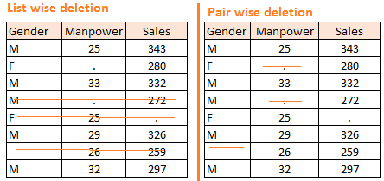
Removing Missing data rows
The two most common methods for removing missing data are:
 | Listwise deletion (complete case analysis) | Pairwise deletion
Description: | Analyse the data rows where there is complete data for every column. | Analyse the data rows where the variables of interest have data present.
Advantages: | Simple Easily compare across analyses. | Uses all possible information.
Limitations: | Could be biased (if the data is not MCAR). Lower n, reduces statistical power. | Separate analyses cannot be compared as the data / sample will be different.
Notes:
Draw 2 types of tables for example?

Slide 7
Remove Missing data rows
In R missing values can be represented by:
NA Not Available (placeholder for a missing value).
NULL Empty value.
Inf Infinity.
It is possible to use is.na(), is.null() and is.infinite() functions in R to identify missing, empty and infinite values in datasets.
The function complete.cases() can be used to identify the data rows in a matrix or data frame that are / aren't complete.
  Only NA and NULL are regarded as missing, Inf is treated as valid.

Slide 8
Example Missing dataset
We will be using the following sleep dataset as an example.
It contains the following data on 62 species of mammals:
Various data is missing in the dataset (NA values).
Column | Description
Dream | Length of dreaming sleep
NonD | Non-dreaming sleep
Sleep | Sum of Dream and NonD
BodyWgt | Body weight (kg)
BrainWgt | Brain weight (g)
Span | Life span (yrs)
Gest | Gestation time in days
Pred | Degree to which species were preyed upon (1-low to 5-high scale)
Exp | Degree of their exposure while sleeping (1-low to 5-high scale)
Danger | Overall danger (1-low to 5-high scale)

Slide 9
Replacing Missing data
The two most common methods for replacing missing data are:
 | Simple Imputation | Multiple Imputation
Description: | Missing values are replaced with the mean, median or mode value. | Estimates missing data through repeated simulations.
Stochastic: | No | Yes
Advantages: | Simple. | Variability more accurate.
Limitations: | Could be biased (if the data is not MCAR). Underestimates standard errors. Could distort correlations among variables. | Algorithms are more complex. Normally would require complex coding (R library available).

Slide 10
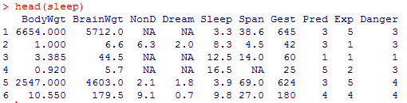
Simple Imputation
Simply replace the missing values with the mean, median or mode:
  mean(x)
  median(x)
  names(sort(-table(x)))[1]
For example, using mean(sleep$x, na.rm=TRUE):
Replace NA values with sleep$x[is.na(sleep$x)] <- value
1.972 (Mean of Dream)
8.672917
(Mean of NonD)
19.87759
(Mean of Span)

Slide 11

Multiple Imputation
The idea of Multiple Imputation is to replace each missing value with multiple acceptable values that represent a distribution of possibilities.
This results in a number of complete datasets (usually 3-10):
Analyse
Impute
Pool
Dataset with missing values
Dataset with multiple imputation applied
Imputed datasets
Analysis results of datasets

Slide 12
Multiple Imputation
  The general procedure for the chained equation approach to multiple imputation (used in mice()) is:
    A simple imputation is performed for every missing value.
    One of the missing variables are set back to missing.
    Regression is performed (linear, logistic, polynomial etc.), the missing variable being the forecast variable and all other variables in the dataset being the predictor variables.
    Missing values are replaced with predictions (imputations) from the regression.
    Repeat steps 2-4 for each variable that has missing data (one cycle).
    Repeat for a number of cycles then retain results as one imputed dataset.

Slide 13
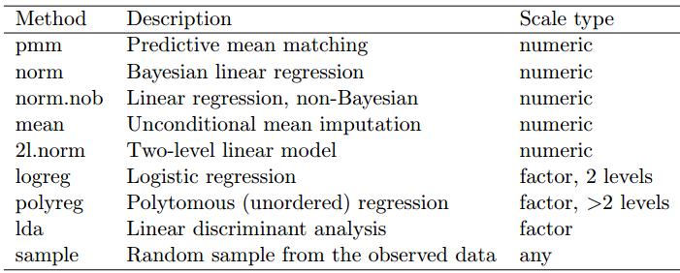
Multiple Imputation
  We will focus on using the mice package.
  The mice package has many built in imputation techniques including:
  Example: mice(data, meth=c('sample','pmm','logreg','norm'))

Slide 14
MISSING DATA
Missing data are observations that we intend to make but couldn’t.
Missing data can occur for many reasons:
  participants can fail to respond to questions (legitimately or illegitimately—more on that later),
  equipment and data collecting or recording mechanisms can malfunction,
  subjects can withdraw from studies before they are completed, and
  data entry errors can occur.
When we have missing data, our goal remains the same with what it was if have the complete data. So, the analysis are now more complex.
How to denote missing data:
SAS .
S+ and R NA or na
-9999 or something like this (Be careful! Make sure that the number is not in the dataset and no one uses them in the analysis)

Slide 15
Missingness Mechanism
Before starting any analysis with incomplete data, we have to clarify the nature of missingness mechanism which causes some values being missing. Previously, there was common belief that the mechanism was random but it was really as it was thought?
Generally, there are two notions accepted for missingness mechanism by all researchers: ignorable and non-ignorable missingness mechanism.
If the mechanism is ignorable we don’t have to care about it and we can ignore it confidently before missing data analysis but if it is not we have to model the mechanism also as part of the parameter estimation.
Identifying the missingness mechanism with a statistical approach is still being a tough problem and so try to develop some diagnostic procedure on missingness mechanism is an important research topic.

Slide 16
Missingness Mechanism
Failure to confirm the assumption of MCAR using statistical tests means that the missing data mechanism is either MAR or MNAR.
Unfortunately, it is impossible to determine whether a mechanism is MAR or MNAR. This is an important practical problem of missing data analysis and classified untestable assumption because we do not know the values of the missing scores, we cannot compare the values of those with and without missing data to see if they differ systematically on that variable (Allison, 2001).
The most of the missing data handling approaches especially EM algorithm and MI relies on MAR assumption (Schafer, 1997). If we can decide that the mechanism that causes missingness is ignorable in such a way, then assuming the mechanism is MAR seems suitable for further analysis. Conducting the EM algorithm and MCMC based MI under MCAR assumption will be also appropriate, since the mechanism of missingness is ignorable (Schafer, 1997).

Slide 17
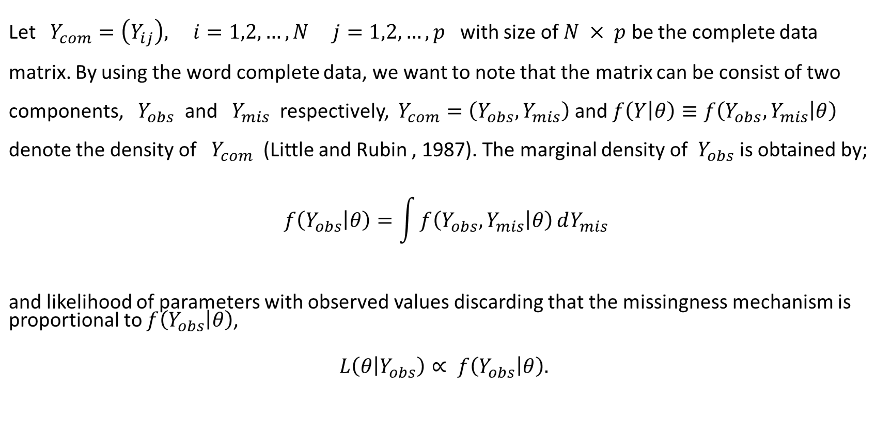
Missingness Mechanism

Slide 18
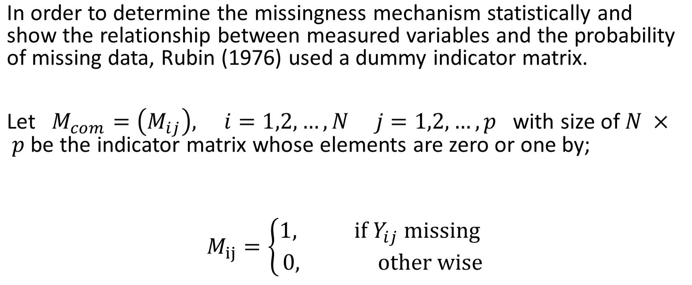
Missingness Mechanism

Slide 19
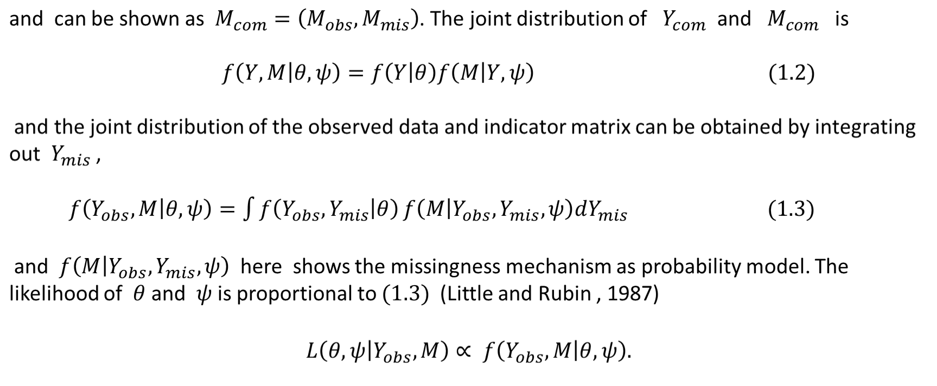
Missingness Mechanism

Slide 20
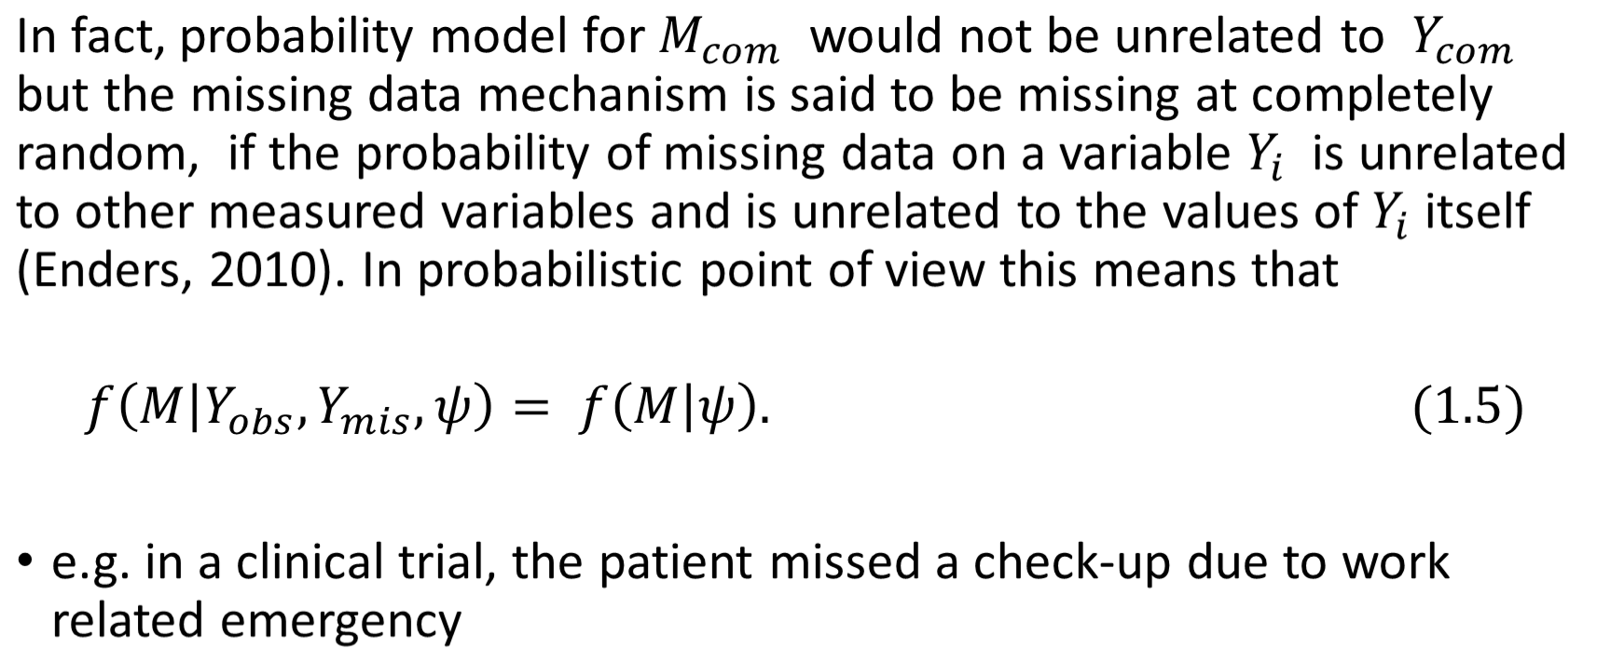
Missing Completely at Random (MCAR)

Slide 21
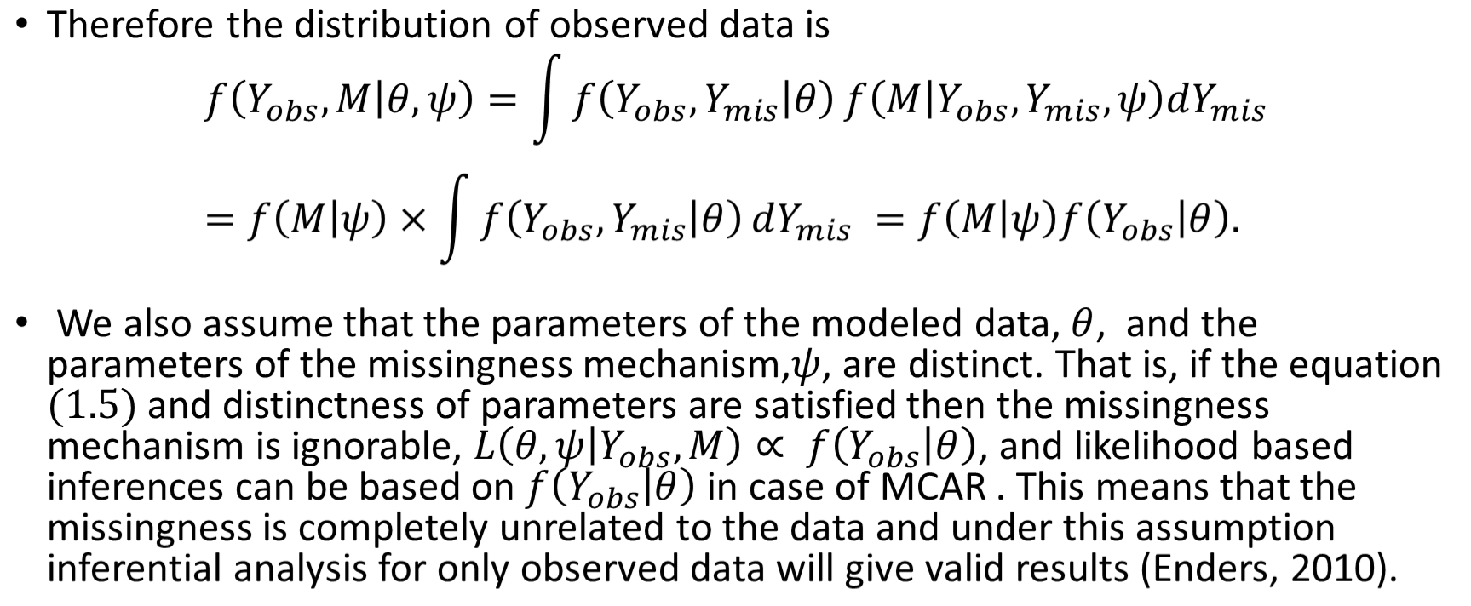
Missing Completely at Random (MCAR)

Slide 22
Missing Completely at Random (MCAR)
Missingness completely at random. A variable is missing completely at random if the probability of missingness is the same for all units, for example, if each survey respondent decides whether to answer the “earnings” question by rolling a die and refusing to answer if a “6” shows up. If data are missing completely at random, then throwing out cases with missing data does not bias your inferences.

Slide 23
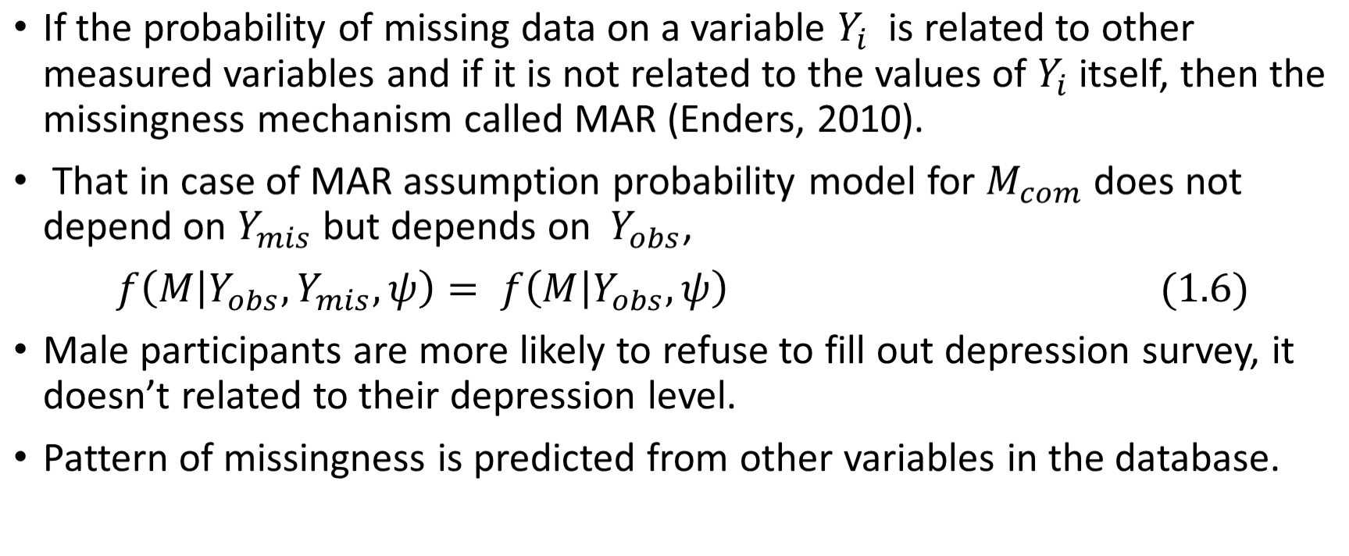
Missing at Random

Slide 24
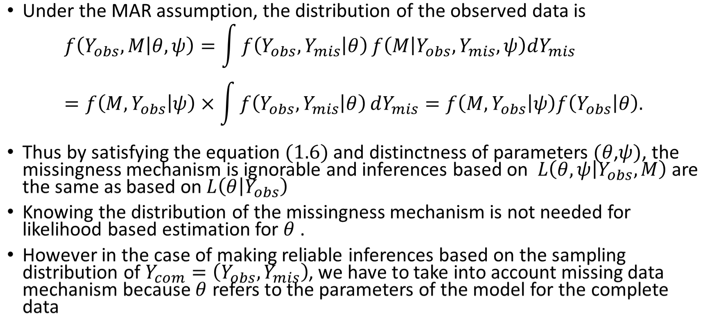
Missing at Random

Slide 25
Missing at Random
A more general assumption, missing at random, is that the probability a variable is missing depends only on available information. Thus, if sex, race, education, and age are recorded for all the people in the survey, then “earnings” is missing at random if the probability of nonresponse to this question depends only on these other, fully recorded variables. It is often reasonable to model this process as a logistic regression, where the outcome variable equals 1 for observed cases and 0 for missing.

Slide 26
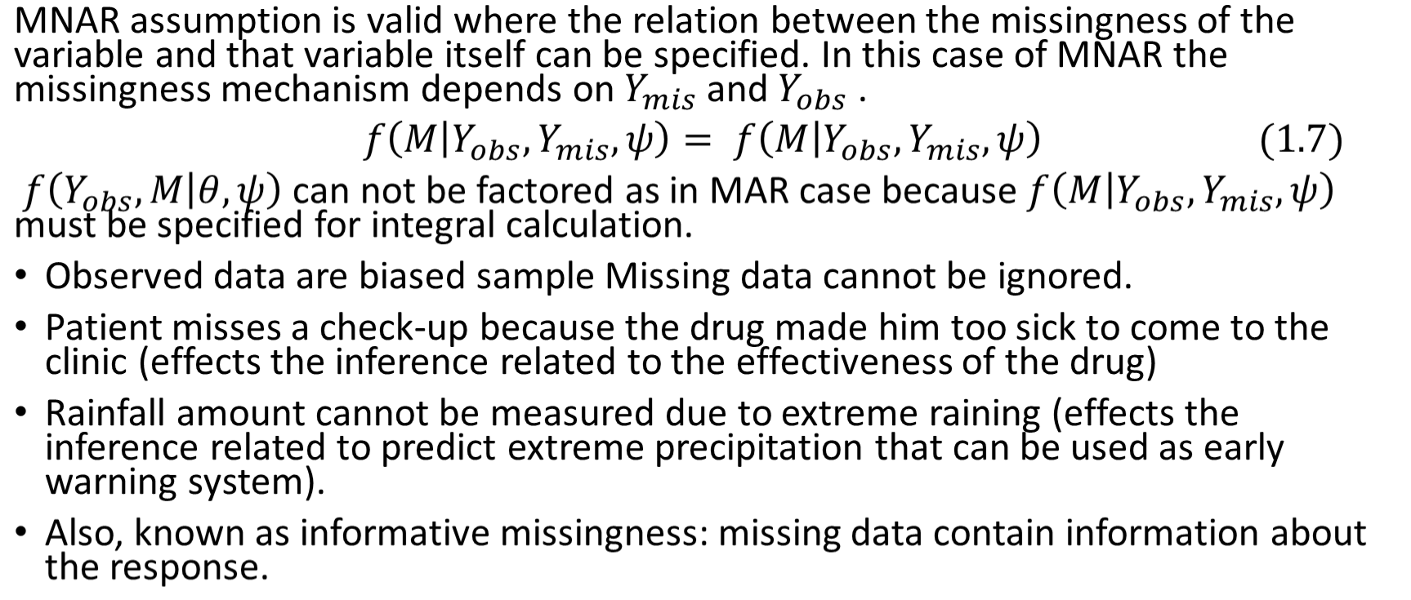
Missing Not at Random

Slide 27
Missing Not at Random
Finally, a particularly difficult situation arises when the probability of missingness depends on the (potentially missing) variable itself. For example, suppose that people with higher earnings are less likely to reveal them. In the extreme case (for example, all persons earning more than $100,000 refuse to respond), this is called censoring, but even the probabilistic case causes difficulty.

Slide 28
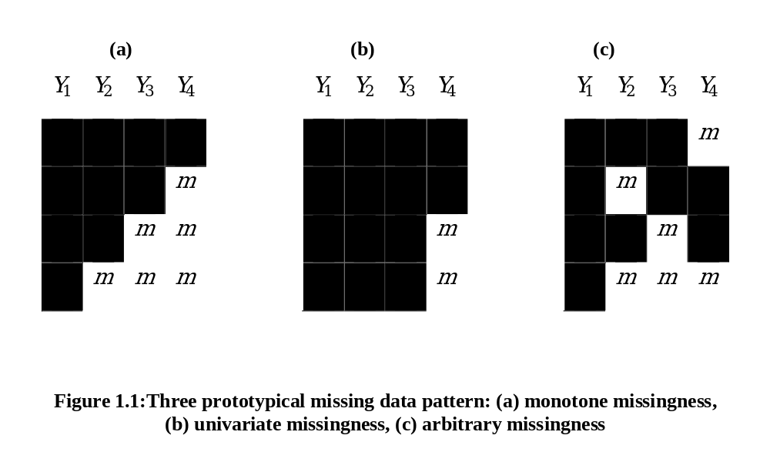
Missing Data Patterns

Slide 29
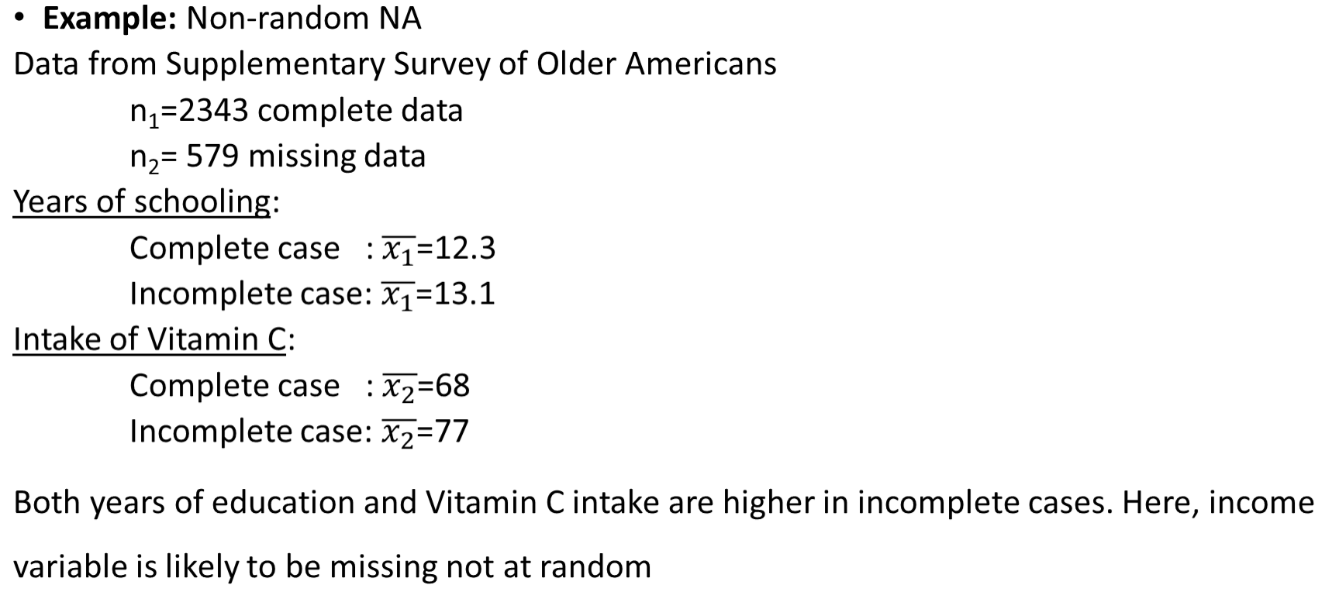
Ways to Understand the Missingness Mechanism within the Data

Slide 30
Ways to Understand the Missingness Mechanism within the Data
It is not possible to extract missing data patterns from observed data but you can explore data to get a sense.
e.g. Assume there are missing data in X₁ variable. Divide X₂ and X₃ into 2 parts from where X₁ is missing and investigate two parts separately. If the results (summary measures or inferences) are different in two part, the missingness in X₁ is possibly not at random.
missing
X₁
X₂
X₃

Slide 31
Ways to Understand the Missingness Mechanism within the Data
Although you can and should explore data, you need to make a reasonable assumption for missing data.
MCAR is a stronger assumption than MAR, and MNAR is hard to model. There is usually very little we can do when the case is missing not at random. Usually, MAR is assumed.
Ask experts why data are missing?

Slide 32
Dealing with Missing Data
Use what you know about
  Why data are missing
  Distribution of missing data
Decide on the best analysis strategy to yield the least biased estimates

Slide 33
Deletion Methods
Delete all cases with incomplete data and conduct analysis using only complete cases.
Advantage: Simplicity
Disadvantage: loss of data if we discard all incomplete cases. So, in efficient
NOTE: If you use complete case analysis, then change summary statistics for other variables, too.

Slide 34
Example: n=19,p=4, only 15% missing values
Individual | Case 1 |  |  |  | Case 2 |  |  |  | Case 3
 | y₁ | y₂ | y₃ | y₄ | y₁ | y₂ | y₃ | y₄ | y₁ | y₂ | y₃ | y₄
1 | NA | NA | NA | NA | NA |  |  |  | NA
2 | NA | NA |  |  | NA |  |  |  | NA
3 |  |  |  |  | NA |  |  |  |  | NA
4 |  |  |  |  | NA |  |  |  |  | NA
5 |  |  |  |  | NA |  |  |  |  |  | NA
6 |  |  |  |  | NA |  |  |  |  |  | NA
7
8
9
10
Eliminate individual 1 and 2.
Keep 8*4=32 data. 20% loss
Eliminate variable 1.
Keep 10*3=30 data. 25% loss
Eliminate individual 1 -6.
Keep 4*4=16 data. 60% loss

Slide 35
Listwise Deletion (Complete case analysis)
Only analyze cases with available data on each variable
Advantage: simplicity and comparability across analyses
Disadvantage: reduces statistical power (due to sample size), not use all information, estimates may be biased if data not MCAR
Listwise deletion often produces unbiased regression slope estimates as long as missingness is not a function of outcome variable.

Slide 36
Pairwise Deletion (Available case analysis)
Analysis with all cases in which the variables of interest are present
Advantage: keeps as many cases as possible for each analysis, uses all information possible with each analysis
Disadvantage: cannot compare analyses because sample is different each time, sample size vary for each parameter estimation, can obtain nonsense results
Compute the summary statistics using n_{i} observations not n.
Compute correlation type statistics using complete pairs for both variables.

Slide 37
Example

Slide 38
Imputation Methods
1. Random sample from existing values:
You can randomly generate an integer from 1 to n-n_{missing}, then replace the missing value with the corresponding observation that you chose randomly
Case: 1 2 3 4 5 6 7 8 9 10
Y₁: 3.4 3.9 2.6 1.9 2.2 3.3 1.7 2.4 2.8 3.6
Y₂: 5.7 4.8 4.9 6.2 6.8 5.6 5.4 4.9 5.7 NA
Randomly generate number between 1 and 9: Say 3
Replace Y_{2,10} by Y_{2,3}=4.9
Disadvantage: It may change the distribution of data
4.9

Slide 39
Imputation Methods
2. Randomly sample from a reasonable distribution
e.g. If gender is missing and you have the information that there re about the sample number of females and males in the population.
Gender ~Ber(p=0.5) or estimate p from the observed sample
Using random number generator from Bernoulli distribution for p=0.5, generate numbers for missing gender data
Disadvantage: distributional assumption may not be reliable (or correct), even the assumption is correct, its representativeness is doubtful.

Slide 40
Imputation Methods
3. Mean/Mode Substitution
Replace missing value with the sample mean or mode. Then, run analyses as if all complete cases
Advantage: We can use complete case analyses
Disadvantage: Reduces variability, weakens the correlation estimates because it ignores the relationship between variables, it creates artificial band
Unless the proportion of missing data is low, do not use this method.

Slide 41
Last Observation Carried Forward
This method is specific to longitudinal data problems.
For each individual, NAs are replaced by the last observed value of that variable. Then, analyze data as if data were fully observed.
Disadvantage: The covariance structure and distribution change seriously
Observation time
Cases | 1 | 2 | 3 | 4 | 5 | 6
1 | 3.8 | 3.1 | 2.0 | NA | NA | NA
2 | 4.1 | 3.5 | 2.8 | 2.4 | 2.8 | 3.0
3 | 2.7 | 2.4 | 2.9 | 3.5 | NA | NA
2.0
2.0
2.0
3.5
3.5

Slide 42
Imputation Methods
4. Dummy variable adjustment
Create an indicator variable for missing value (1 for missing, 0 for observed)
Impute missing value to a constant (such as mean)
Include missing indicator in the regression
Advantage: Uses all information about missing observation
Disadvantage: Results in biased estimates, not theoretically driven

Slide 43
Imputation Methods
5. Regression imputation
Replace missing values with predicted score from regression equation. Use complete cases to regress the variable with incomplete data on the other complete variables.
Advantage: Uses information from the observed data, gives better results than previous ones
Disadvantage: over-estimates model fit and correlation estimates, weakens variance

Slide 44
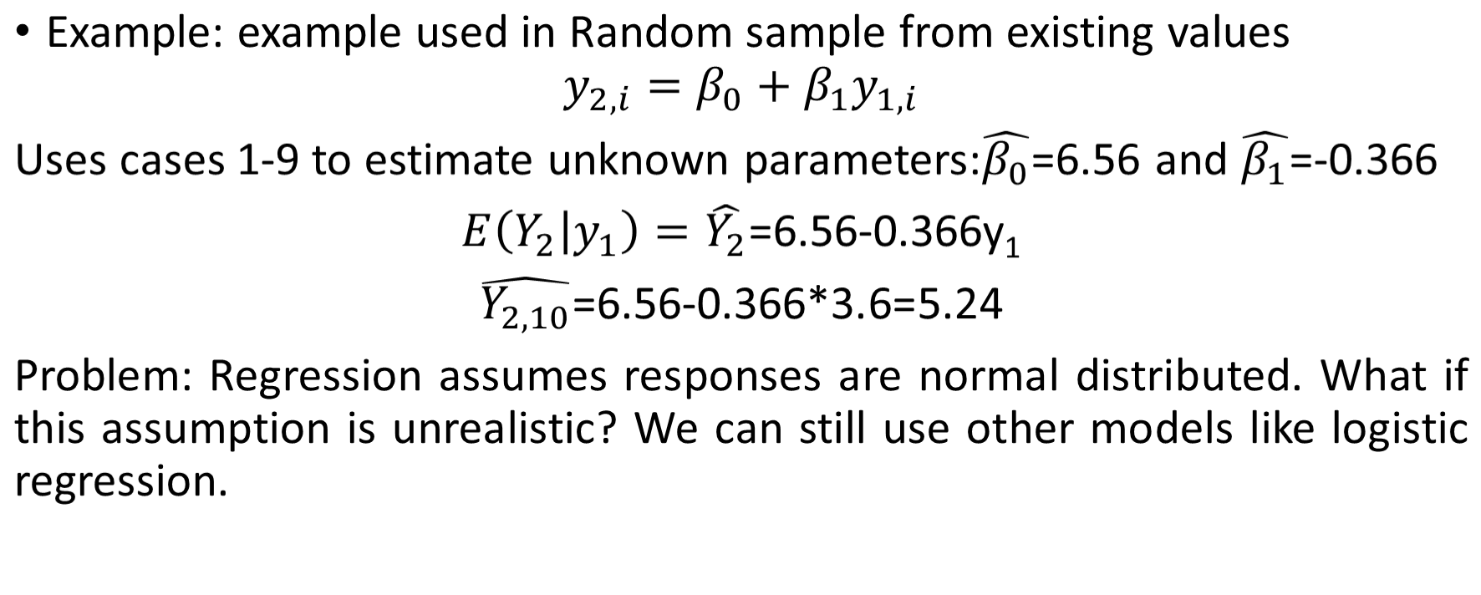
Imputation Methods

Slide 45
Imputation Methods
6. Maximum Likelihood Estimation
Identifies the set of parameter values that produces the highest log-likelihood.
ML estimate: value that is most likely to have resulted in the observed data.
Advantage: uses full information (both complete and incomplete) to calculate the log-likelihood, unbiased parameter estimates with MCAR/MAR data
Disadvantage: Standard errors biased downward but this can be adjusted by using observed information matrix.

Slide 46
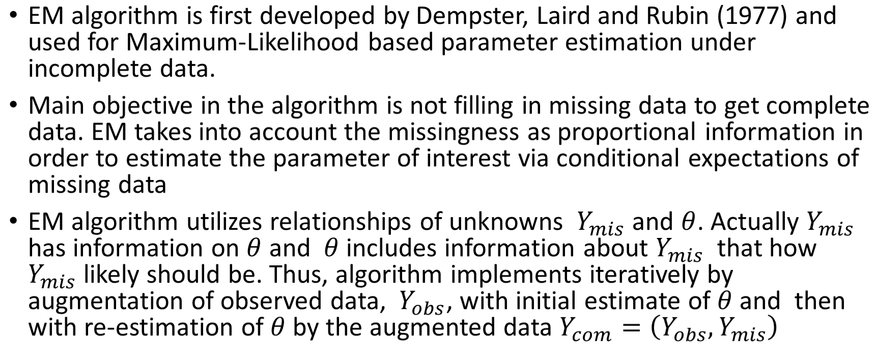
Imputation Methods

Slide 47
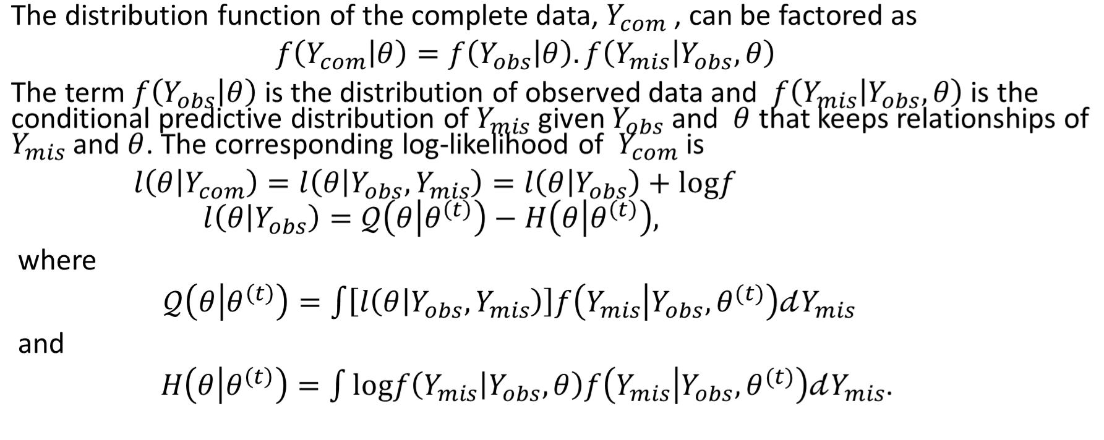
Imputation Methods

Slide 48
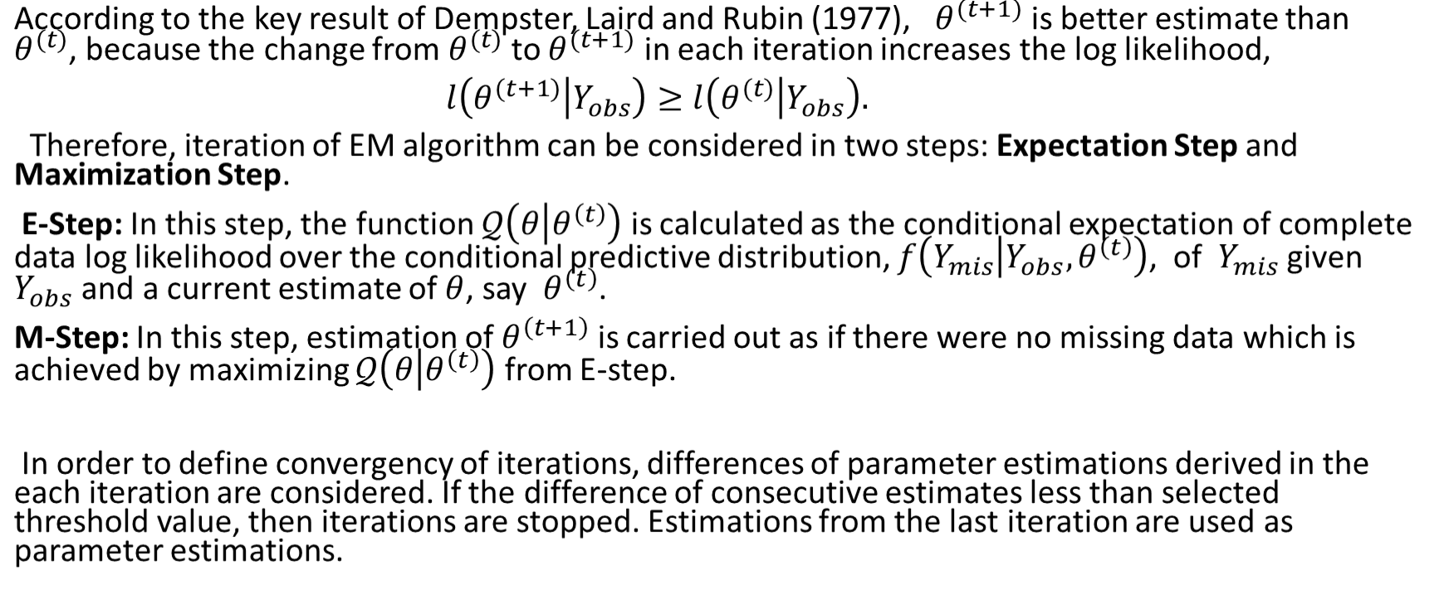
Imputation Methods

Slide 49
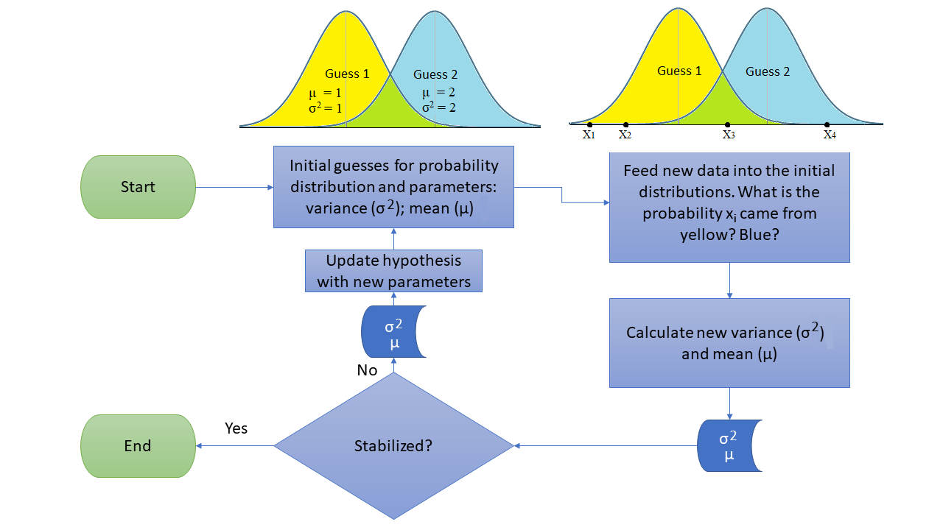

Slide 50
Multiple Imputation (MI)
Multiple imputation (MI) appears to be one of the most attractive methods for general- purpose handling of missing data in multivariate analysis. The basic idea, first proposed by Rubin (1977) and elaborated in his (1987) book, is quite simple:
Impute missing values using an appropriate model that incorporates random variation.
Do this M times producing M “complete” data sets.
Perform the desired analysis on each data set using standard complete-data methods.
Average the values of the parameter estimates across the M samples to produce a single point estimate.
Calculate the standard errors by (a) averaging the squared standard errors of the M estimates (b) calculating the variance of the M parameter estimates across samples, and (c) combining the two quantities using a simple formula

Slide 51
Multiple Imputation
Multiple imputation has several desirable features:
Introducing appropriate random error into the imputation process makes it possible to get approximately unbiased estimates of all parameters. No deterministic imputation method can do this in general settings.
Repeated imputation allows one to get good estimates of the standard errors. Single imputation methods don’t allow for the additional error introduced by imputation (without specialized software of very limited generality).

Slide 52
Multiple Imputation
With regards to the assumptions needed for MI,
First, the data must be missing at random (MAR), meaning that the probability of missing data on a particular variable Y can depend on other observed variables, but not on Y itself (controlling for the other observed variables).
Example: Data are MAR if the probability of missing income depends on marital status, but within each marital status, the probability of missing income does not depend on income; e.g. single people may be more likely to be missing data on income, but low income single people are no more likely to be missing income than are high income single people.
Second, the model used to generate the imputed values must be “correct” in some sense.
Third, the model used for the analysis must match up, in some sense, with the model used in the imputation

Slide 53
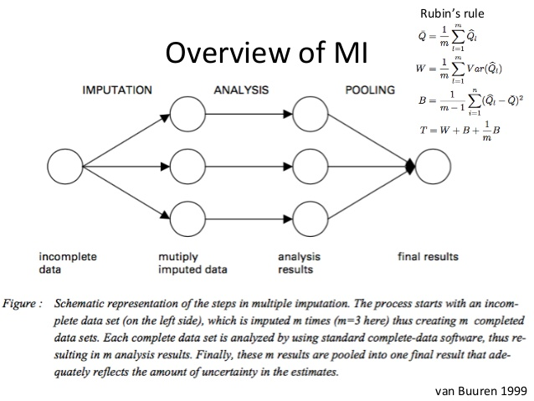
Multiple Imputation

Slide 54
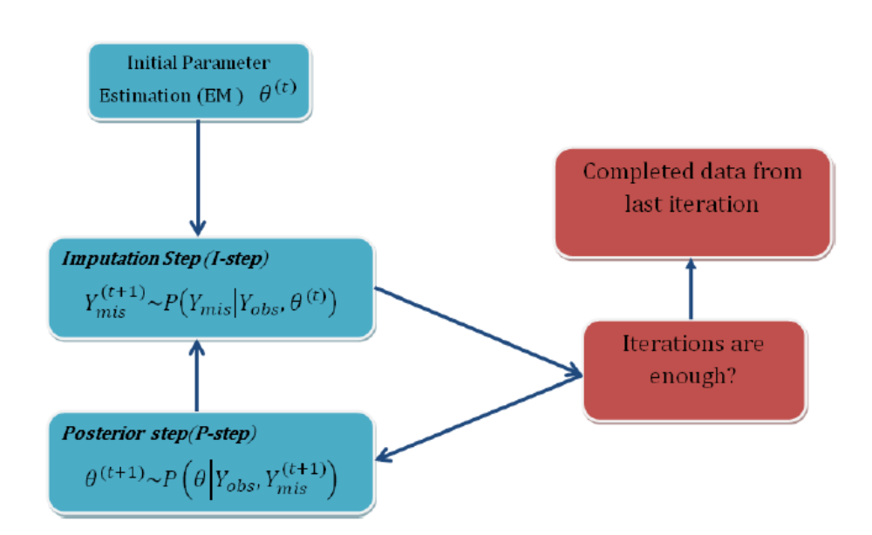
EM-MCMC Multiple Imputation

Slide 55
Imputation in R
MICE (Multivariate Imputation via Chained Equations): Creating multiple imputations as compared to a single imputation (such as mean) takes care of uncertainty in missing values. It assumes MAR
Amelia(https://cran.r-project.org/web/packages/Amelia/vignettes/amelia.pdf): This package (Amelia II) is named after Amelia Earhart, the first female aviator to fly solo across the Atlantic Ocean. History says, she got mysteriously disappeared (missing) while flying over the pacific ocean in 1937, hence this package was named to solve missing value problems. This package also performs multiple imputation to deal with missing values. It is enabled with bootstrap based EMB algorithm which makes it faster and robust to impute many variables including cross sectional, time series data etc. Also, it is enabled with parallel imputation feature using multicore CPUs. Assumptions: All variables in a data set have Multivariate Normal Distribution (MVN) and MAR
missForest: an implementation of random forest algorithm. It’s a non parametric imputation method applicable to various variable types. It builds a random forest model for each variable. Then it uses the model to predict missing values in the variable with the help of observed values. It yield OOB (out of bag) imputation error estimate. Moreover, it provides high level of control on imputation process.
Hmisc: a multiple purpose package useful for data analysis, high – level graphics, imputing missing values, advanced table making, model fitting & diagnostics (linear regression, logistic regression & cox regression) etc. impute() function simply imputes missing value using user defined statistical method (mean, max, mean). It’s default is median. On the other hand, aregImpute() allows mean imputation using additive regression, bootstrapping, and predictive mean matching. In bootstrapping, different bootstrap resamples are used for each of multiple imputations. Then, a flexible additive model (non parametric regression method) is fitted on samples taken with replacements from original data and missing values (acts as dependent variable) are predicted using non-missing values (independent variable).
mi: (Multiple imputation with diagnostics) package provides several features for dealing with missing values. It also builds multiple imputation models to approximate missing values. And, uses predictive mean matching method. For each observation in a variable with missing value, we find observation (from available values) with the closest predictive mean to that variable. The observed value from this “match” is then used as imputed value.

Slide 56
EXAMPLE (https://www.kdnuggets.com/2017/09/missing-data-imputation-using-r.html )
#Loading the mice package
library(mice)
#Loading the following package for looking at the missing values
library(VIM)
library(lattice)
data(nhanes)
# First look at the data
str(nhanes)
'data.frame': 25 obs. of 4 variables:
$ age: num 1 2 1 3 1 3 1 1 2 2 ...
$ bmi: num NA 22.7 NA NA 20.4 NA 22.5 30.1 22 NA ...
$ hyp: num NA 1 1 NA 1 NA 1 1 1 NA ...
$ chl: num NA 187 187 NA 113 184 118 187 238 NA ...

Slide 57
The str function shows us that bmi, hyp and chl has NA values which means missing values. The age variable does not happen to have any missing values. The age values are only 1, 2 and 3 which indicate the age bands 20-39, 40-59 and 60+ respectively. These values are better represented as factors rather than numeric. Let’s convert them:
#Convert Age to factor
nhanes$age=as.factor(nhanes$age)
It’s time to get our hands dirty. Let’s observe the missing values in the data first. The mice package provides a function md.pattern() for this:
> #understand the missing value pattern
> md.pattern(nhanes)
age hyp bmi chl
13 1 1 1 1 0
1 1 1 0 1 1
3 1 1 1 0 1
1 1 0 0 1 2
7 1 0 0 0 3
0 8 9 10 27
The output can be understood as follows. 1’s and 0’s under each variable represent their presence and missing state respectively.
There are 13 (out of 25) rows that are complete. There is one row for which only bmi is missing, and there are seven rows for which only age is known. The total number of missing values is equal to (7 x 3) + (1 x 2) + (3 x 1) + (1 x 1) = 27. Most missing values (10) occur
in chl. There are 5 different missingness patterns. The VIM package is a very useful package to visualize these missing values.

Slide 58
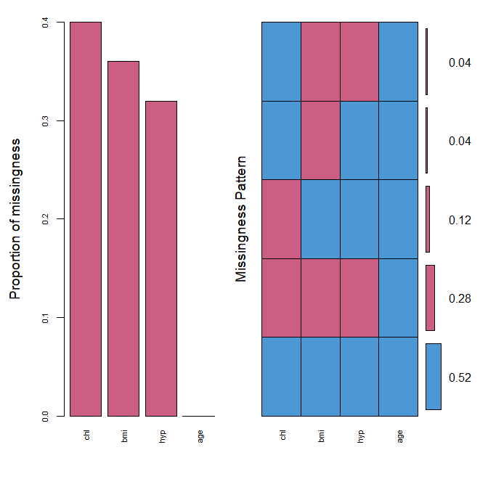
> #plot the missing values
> nhanes_miss = aggr(nhanes, col=mdc(1:2), numbers=TRUE, sortVars=TRUE, labels=names(nhanes), cex.axis=.7, gap=3, ylab=c("Proportion of missingness","Missingness Pattern"))
Variables sorted by number of missings:
Variable Count
chl 0.40
bmi 0.36
hyp 0.32
age 0.00
We see that the variables have missing values from 30-40%. It also shows the different types of missing patterns and their ratios. The next thing is to draw a margin plot which is also part of VIM package.

Slide 59
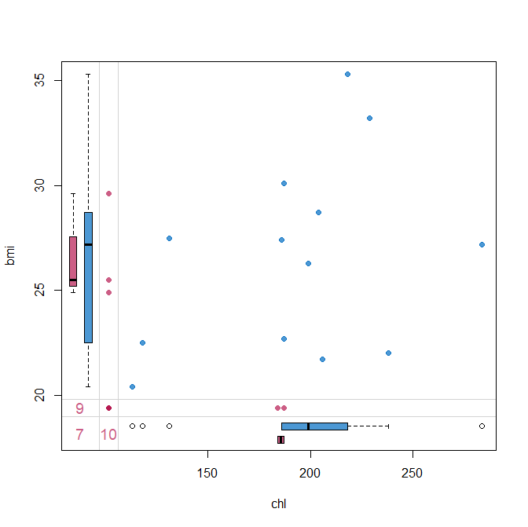
> #Drawing margin plot
> marginplot(nhanes[, c("chl", "bmi")], col = mdc(1:2), cex.numbers = 1.2, pch = 19)
The data area holds 13 blue points for which both bmi and chl were observed. The three red dots in the left margin correspond to the records for which bmi is observed and chl is missing. The points are drawn at the known values of bmi at 24.9, 25.5 and 29.6. Likewise, the bottom margin contain two red points with observed chl and missing bmi. The red dot at the intersection of the bottom and left margin indicates that there are records for which both bmi and chl are missing. The three numbers at the lower left corner indicate the number of incomplete records for various combinations. There are 9 records in which bmi is missing, 10 records in which chl is missing, and 7 records in which both are missing.
The margin plot, plots two features at a time. The red plot indicates distribution of one feature when it is missing while the blue box is the distribution of all others when the feature is present. This plot is useful to understand if the missing values are MCAR. For MCAR values, the red and blue boxes will be identical.

Slide 60
Let’s try to apply mice package and impute the chl values:
#Imputing missing values using mice
mice_imputes = mice(nhanes, m=5, maxit = 40)
iter imp variable
1 1 bmi hyp chl
1 2 bmi hyp chl
1 3 bmi hyp chl
1 4 bmi hyp chl
1 5 bmi hyp chl
…
40 3 bmi hyp chl
40 4 bmi hyp chl
40 5 bmi hyp chl

Slide 61
Here, we used three parameters for the package.
The first is the dataset, the second is the number of times the model should run. I have used the default value of 5 here. This means that I now have 5 imputed datasets. Every dataset was created after a maximum of 40 iterations which is indicated by “maxit” parameter. It uses predictive mean matching (pmm) method.
Let’s see the methods used for imputing:
> #What methods were used for imputing
> mice_imputes$method
age bmi hyp chl
"" "pmm" "pmm" "pmm"
Since all the variables were numeric, the package used pmm for all features.
> #Imputed dataset
> Imputed_data=complete(mice_imputes,5)
> Imputed_data
age bmi hyp chl
1 1 35.3 1 218
2 2 22.7 1 187
3 1 35.3 1 187
4 3 22.7 1 229

Slide 62
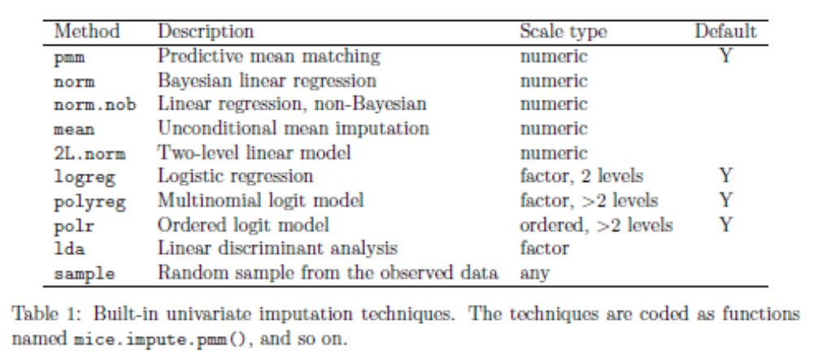
Estimation methods that mice uses

Slide 63
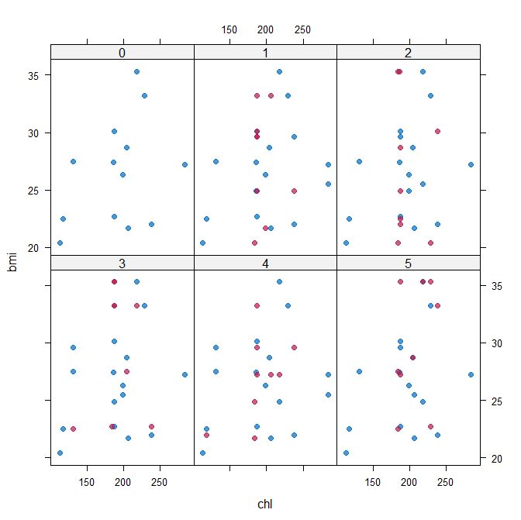
Goodness of fit
The values are imputed but how good were they? The xyplot() and densityplot() functions come into picture and help us verify our imputations.
#Plotting and comparing values with xyplot()
xyplot(mice_imputes, bmi ~ chl | .imp, pch = 20, cex = 1.4)
Here again, the blue ones are the observed data and red ones are imputed data. The red points should ideally be similar to the blue ones so that the imputed values are similar. We can also look at the density plot of the data.

Slide 64
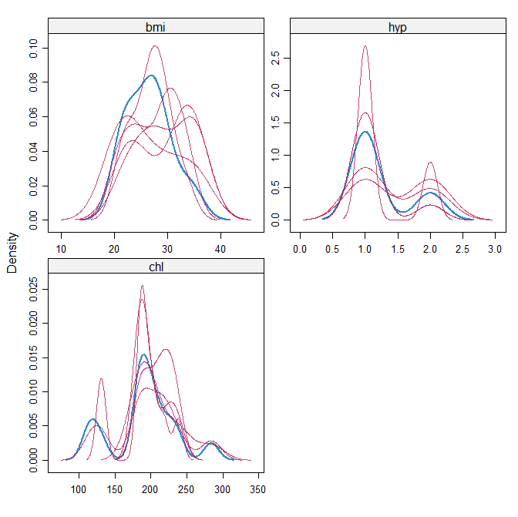
#make a density plot
densityplot(mice_imputes)
Just as it was for the xyplot(), the red imputed values should be similar to the blue imputed values for them to be MAR here.

Slide 65
Pooling
Suppose that the next step in our analysis is to fit a linear model to the data. You may ask what imputed dataset to choose. The mice package makes it again very easy to fit a model to each of the imputed dataset and then pool the results together.
> imp = mice(nhanes, m=5, maxit = 40,print=F)
> modelFit <- with(imp,lm(bmi~ age+chl+hyp))
> summary(modelFit)
## summary of imputation 1 :
Residuals:
Min 1Q Median 3Q Max
-7.4493 -1.2604 -0.3604 2.0396 6.2875
Coefficients:
Estimate Std. Error t value Pr(>|t|)
(Intercept) 15.98838 3.75141 4.262 0.000381 ***
age2 -3.90313 1.79978 -2.169 0.042340 *
age3 -6.36550 1.86532 -3.413 0.002760 **
chl 0.04684 0.01850 2.532 0.019846 *
hyp 2.81234 1.76160 1.596 0.126064
---
Signif. codes: 0 ‘***’ 0.001 ‘**’ 0.01 ‘*’ 0.05 ‘.’ 0.1 ‘ ’ 1
Residual standard error: 3.132 on 20 degrees of freedom
Multiple R-squared: 0.427, Adjusted R-squared: 0.3124
F-statistic: 3.726 on 4 and 20 DF, p-value: 0.02011
## summary of imputation 2 :
...

Slide 66
> class(modelFit)
[1] "mira" "matrix“
> pool.fit <- pool(modelFit)
> summary(pool.fit)
est se t df Pr(>|t|) lo 95
(Intercept) 16.749237 4.75207687 3.524614 6.146734 0.011962515 5.188279474
age2 -5.352022 1.95856224 -2.732628 10.056164 0.020997775 -9.712669499
age3 -7.009693 1.86438114 -3.759796 16.936423 0.001570174 -10.944318808
chl 0.052366 0.02459881 2.128802 5.421676 0.082239396 -0.009416271
hyp 2.323475 1.91571926 1.212847 13.974606 0.245292742 -1.786034437
hi 95 nmis fmi lambda
(Intercept) 28.3101939 NA 0.5933071 0.47949492
age2 -0.9913751 NA 0.4030238 0.29503410
age3 -3.0750678 NA 0.1531897 0.05876619
chl 0.1141483 10 0.6381817 0.52549515
hyp 6.4329850 8 0.2587789 0.15978179
Fraction of missing information
Proportion of total variance due to missingness

Slide 67
For more examples using mice package, you can visit https://datascienceplus.com/imputing-missing-data-with-r-mice-package/
To get more info on Amelia package, you can visit https://www.linkedin.com/pulse/amelia-packager-missing-data-imputation-ramprakash-veluchamy/

